Slide 1
 | Recognizer | Generator
Regular language | DFA or NFA | Regular expression
Context Free language | PDA | Context Free Grammar
Context Free languages
Regular languages

Slide 2
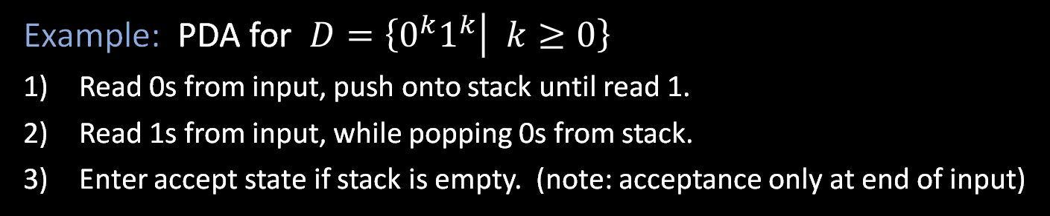
Pushdown Automata (PDA)
“head”
…
a
b
a
b
a
a
Finite control
input appears on a “tape”
c
Schematic diagram for DFA or NFA
d
(pushdown) stack
d
Schematic diagram for PDA
Operates like an NFA except can write-add or read-remove symbols from the top of stack.
push
pop
Example: PDA for $D=\left\{0^{k}1^{k} | k≥0\right\}$
Read 0s from input, push onto stack until read 1.
Read 1s from input, while popping 0s from stack.
Enter accept state if stack is empty. (note: acceptance only at end of input)

Slide 3


PDA – Formal Definition
Defn: A Pushdown Automaton (PDA) is a 6-tuple $(Q, Σ, Γ, δ, q0, F)$
$Σ$ input alphabet
$Γ$ stack alphabet
$δ: Q×Σ_{ε}×Γ_{ε}→𝒫(Q×Γ_{ε})$
$δ\left(q,\text{a},\text{c}\right)=\left\{\left(r_{1},\text{d}\right), \left(r_{2}, \text{e}\right)\right\}$
pop
push
Accept if some thread is in the accept state at the end of the input string.
Example: PDA for $B=\{ww^{ℛ}|$ $w∈{\left\{0,1\right\}}^{∗} \}$
Read and push input symbols. Nondeterministically either repeat or go to (2).
Read input symbols and pop stack symbols, compare. If ever $≠$ then thread rejects.
Enter accept state if stack is empty (use $ as a symbol of empty stack).
Sample input:
0
1
1
1
1
0
This language requires nondeterminism. Our PDA model is nondeterministic.

Slide 4




Transitions in PDA
a, b
c
V_{i}
V_{j}
From state V_{i} read input a, pop b from stack, and push c into stack then move to state V_{j}
$ε$, b
c
V_{i}
V_{j}
From state V_{i} without reading input, pop b from stack, and push c into stack then move to state V_{j}
$\text{a}$, $ε$
c
V_{i}
V_{j}
From state V_{i} read input a, without popping from stack, push c into stack then move to state V_{j}
$\text{a}$, b
$$ε$$
V_{i}
V_{j}
From state V_{i} read input a, pop b from stack, and without pushing into stack, move to state V_{j}

Slide 5




Converting CFGs to PDAs
Theorem: If $A$ is a CFL then some PDA recognizes $A$
Proof: Convert $A$’s CFG to a PDA
IDEA: PDA begins with starting variable and guesses substitutions. It keeps intermediate generated strings on stack. When done, compare with input.
Problem! Access below the top of stack is cheating!
Instead, only substitute variables when on the top of stack.
If a terminal is on the top of stack, pop it and compare with input. Reject if $≠$.
E $→$ E+T | T
T $→$ …
F $→$ …
PDA
…
CFG
$$G_{2}$$
E $→$ E+T | T
T $→$ T×F | F
F $→$ ( E ) | a
E
E
T
T
+
+
+
Input:
a
+
a
×
a
T
T
T
E
E+T
T+T×F
F+F×a
a+a×a
E
E+T
T T× F
F F a
a a a
×
F

Slide 6


Converting CFGs to PDAs (contd.)
$$G_{2}$$
E $→$ E+T | T
T $→$ T×F | F
F $→$ ( E ) | a
Theorem: If $A$ is a CFL then some PDA recognizes $A$
Proof construction: Convert the CFG for $A$ to the following PDA.
Push the start symbol on the stack.
If the top of stack is
Variable: replace with right hand side of rule (nondet choice).
Terminal: pop it and match with next input symbol.
If the stack is empty, accept.
Example input:
E
E+T
T+T×F
F+F×a
a+a×a
E
E+T
T T× F
F F a
a a a
a
+
a
×
a
E
E
T
F
a
+
T
T
+
+
+
+
T
×
T
T
T
T
F
…

Slide 7


















Proving languages not Context Free
Let $B=\left\{0^{k}1^{k}2^{k}\right| k≥0\}$. We will show that $B$ isn’t a CFL.
Pumping Lemma for CFLs: For every CFL $A$, there is a $p$ such that if $s∈A$ and $\left|s\right|≥p$ then $s=uvxyz$ where
1) $uv^{i}xy^{i}z∈A$ for all $i≥0$
2) $vy≠\text{ε}$
3) $\left|vxy\right|≤p$
Informally: All long strings in $A$ are pumpable and stay in $A$.
$$≥p$$
$$u$$
$$v$$
$$x$$
$$y$$
$$z$$
$$s=$$
$∈A$
$∈A$
$$u$$
$$v$$
$$v$$
$$x$$
$$y$$
$$y$$
$$z$$
$$≤p$$

Slide 8









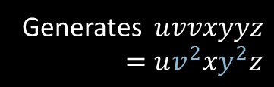












Pumping Lemma – Proof
Pumping Lemma for CFLs: For every CFL $A$, there is a $p$ such that if $s∈A$ and $\left|s\right|≥p$ then $s=uvxyz$ where
1) $uv^{i}xy^{i}z∈A$ for all $i≥0$
2) $vy≠\text{ε}$
3) $\left|vxy\right|≤p$
E
Proof by picture:
E
R
E
R
$$u$$
$$v$$
$$y$$
$$z$$
R
R
R
$$x$$
$$v$$
$$x$$
$$y$$
Generates $uvvxyyz$
$=uv^{2}xy^{2}z$
$$u$$
$$z$$
R
Generates $uxz$
$=uv^{0}xy^{0}z$
$$s=$$
$$u$$
$$v$$
$$x$$
$$y$$
$$z$$
Long $s→$ tall parse tree
“cutting and pasting” argument

Slide 9










Example 1 of Proving Non-CF
Pumping Lemma for CFLs: For every CFL $A$, there is a $p$ such that if $s∈A$ and $\left|s\right|≥p$ then $s=uvxyz$ where
1) $uv^{i}xy^{i}z∈A$ for all $i≥0$
2) $vy≠\text{ε}$
3) $\left|vxy\right|≤p$
Let $B=\left\{0^{k}1^{k}2^{k}\right| k≥0\}$
Show: $B$ is not a CFL
Proof by Contradiction:
Assume (to get a contradiction) that $B$ is a CFL .
The CFL pumping lemma gives $p$ as above. Let $s=0^{p}1^{p}2^{p}∈B$.
Pumping lemma says that can divide $s=uvxyz$ satisfying the 3 conditions.
Condition 3 ($\left|vxy\right|≤p$) implies that $vxy$cannot contain both 0s and 2s.
So $uv^{2}xy^{2}z$ has unequal numbers of 0s, 1s, and 2s.
Thus, $uv^{2}xy^{2}z∉B$, violating Condition 1. Contradiction! Therefore, our assumption ($B$ is a CFL) is false. We conclude that $B$ is not a CFL .
$$s=$$
$$00⋯0011⋯1122⋯22$$
$$u$$
$$v$$
$$x$$
$$y$$
$$z$$
$$≤p$$

Slide 10
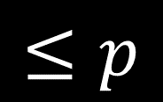










Example 2 of Proving Non-CF
Pumping Lemma for CFLs: For every CFL $A$, there is a $p$ such that if $s∈A$ and $\left|s\right|≥p$ then $s=uvxyz$ where
1) $uv^{i}xy^{i}z∈A$ for all $i≥0$
2) $vy≠\text{ε}$
3) $\left|vxy\right|≤p$
Let $F=\left\{ww\right| w∈Σ^{∗}\} .$ $Σ=\{0,1\}$.
Show: $F$ is not a CFL.
Assume (for contradiction) that $F$ is a CFL.
The CFL pumping lemma gives $p$ as above. Need to choose $s∈F$. Which $s$?
Try $s_{1}=0^{p}10^{p}1∈F$. But $s_{1}$ can be pumped and stay inside $F$. Bad choice of $s$.
Try $s_{2}=0^{p}{1^{p}0}^{p}1^{p}∈F$. Show $s_{2}$ cannot be pumped $s_{2}=uvxyz$ satisfying the 3 conditions.
Condition 3 implies that $vxy$ does not overlap two runs of 0s or two runs of 1s.
Therefore, in $uv^{2}xy^{2}z$, two runs of 0s or two runs of 1s have unequal length.
So $uv^{2}xy^{2}z∉F$ violating Condition 1. Contradiction! Thus, $F$ is not a CFL.
$$s_{1}=$$
$$000⋯001000⋯001$$
$$u$$
$$v$$
$$x$$
$$y$$
$$z$$
$$s_{2}=$$
$$0⋯01⋯10⋯01⋯1$$
$$u$$
$$v$$
$$x$$
$$y$$
$$z$$

